Slide 1
NoSQL
Overview, design and variations

Slide 2
Overview
In the past few years, the ”one size fits all“-thinking concerning datastores has been questioned by both, science and web affine companies, which has lead to the emergence of a great variety of alternative databases. The movement as well as the new datastores are commonly subsumed under the term NoSQL, “used to describe the increasing usage of non-relational databases among Web developers” (cf. [Oba09a]).
The aims is to systematic overview of the motives and rationales directing this movement
common concepts, techniques and patterns and several classes of NoSQL databases (key-/value-stores, document databases, column-oriented databases) and individual products.

Slide 3
The NoSQL-Movement
Avoidance of Unneeded Complexity Relational databases provide a variety of features and strict data consistency. But this rich feature set and the ACID properties implemented by RDBMSs might be more than necessary for particular applications and use cases.
High Throughput Some NoSQL databases provide a significantly higher data throughput than traditional RDBMSs. Google is able to process 20 petabyte a day stored in Bigtable via it’s MapReduce approach
Horizontal Scalability and Running on Commodity Hardware: VOLUME
1. Scale out data (e. g. 3 TB for the green badges feature at Digg, 50 GB for the inbox search at Facebook or 2 PB in total at eBay)
2. Performance of single servers
3. Rigid schema design
NoSQL databases are designed to scale well in the horizontal direction and not rely on highly available hardware.

Slide 4
The NoSQL-Movement
Avoidance of Expensive Object-Relational Mapping : NoSQL databases are designed to store data structures that are either simple or more similar to the ones of object-oriented programming languages compared to relational data structures.
Complexity and Cost of Setting up Database Clusters : NoSQL databases are designed in a way that “PC clusters can be easily and cheaply expanded without the complexity and cost of ’sharding,’ which involves cutting up databases into multiple tables to run on large clusters or grids”.
Compromising Reliability for Better Performance.
The Current “One size fit’s it all” Databases Thinking Was and Is Wrong: growing number of application scenarios cannot be addressed with a traditional database approach, alternatives towards traditional RDBMSs can be explained by two major trends:
1. The continuous growth of data volumes (to be stored)
2. The growing need to process larger amounts of data in shorter time

Slide 5
The NoSQL-Movement
The Myth of Effortless Distribution and Partitioning of Centralized Data Models
Movements in Programming Languages and Development Frameworks: frameworks that provide abstractions for database access trying to hide the use of SQL ,
Object-relational mappers in the Java and .NET world like the Java Persistence API (JPA, part of the EJB 3 specification,)
Likewise, the popular Ruby on Rails (RoR, [HR10]) framework and others try to hide away the usage of a relational
NoSQL datastores as well as some databases offered by cloud computing providers completely omit a relational database. One example of such a cloud datastore is Amazon’s SimpleDB, a schema free,

Slide 6
RDMS Alternative: Distributed DB
“Essentially everyone, when they first build a distributed application, makes the following Nine assumptions. All prove to be false in the long run and all cause big trouble and painful learning experiences.”
1. The network is reliable
2. Latency is zero
3. Bandwidth is infinite
4. The network is secure
5. Topology doesn’t change
6. There is one administrator
7. Transport cost is zero
8. The network is homogeneous.
9. Development Cost is high.

Slide 7
Design Considerations
Why relational DBMSs can be outperformed even in their home market of business data processing and how their own DMBS prototype H-Store can “achieve dramatically better performance than current RDBMSs”.
Main Memory: “The overwhelming majority of OLTP databases are less than 1 Tbyte in size and growing [. . . ] quite slowly”
Multi-Threading and Resource Control : multi-threading systems to maximize CPU- and disk-usage, resource governors limiting load to avoid resource exhausting and multithreaded datastructures like concurrent B-trees.
Grid Computing and Fork-Lift Upgrades The development from shared-memory architectures of the 1970s over shared-disk architectures of the 1980s towards shared nothing approaches of today and the near future, which are “often called grid computing or blade computing”. So partitioning of data over several nodes of a DBMS grid. Furthermore, the need to reload any or all data by an administrator and also without downtimes. These requirements have significant impact on the architecture of DBMSs—e.g. the ability to transfer parts of the data between nodes without impacting running transactions—which probably cannot be easily added to existing RDBMSs but can be considered in the design of new systems

Slide 8
Design Considerations
High Availability high availability and built-in disaster recovery as a crucial feature
for DBMSs has to be considered in the architecture and design of these systems.
No Knobs RDBMSs were designed in an “era, [when] computers were expensive and people were cheap. Today we have the reverse. Personnel costs are the dominant expense in an IT shop”. New databases refers to be ““self-everything” (self-healing, self-maintaining, self- tuning, etc.)”.

Slide 9
Need specialized DBMS:
1. Data warehouses which typically have star or snowflake schemes, i. e. “a central fact table with 1-n joins to surrounding dimension tables, which may in turn participate in further 1-n joins to second level dimension tables, and so forth”. These data structures could be easily modeled using the relational model where an entity-relationship model in this case which would be simpler and more natural to model and to query.
2. The stream processing market has different requirements, namely to “Process streams of messages at high speed [and to] Correlate such streams with stored data”. An SQL generalization called StreamSQL which allows to mix streams and relational data in SQL FROM-clauses has caused some enthusiasm and been suggested for standardization in this field. This showed a problem in stream processing often requiring stream data to be flat (as some news agencies deliver it) but there is also a need for hierarchically structured data. Therefore, they “expect the stream processing vendors to move aggressively to hierarchical data models” and that “they will assuredly deviate from Ted Codd’s principles”.
3. Text processing is a field where relational databases have never been used.
4. Scientific-oriented databases will likely supply arrays rather than tables as their basic data structure.
5. Semi-structured data is a field where useful data models are still being discussed. Suggestions include e. g. XML schema

Slide 10
NoSQL Meant as a Total “No to SQL”
NoSQL also means “Not Only SQL”
Classifications and Comparisons of NoSQL Databases

Slide 11
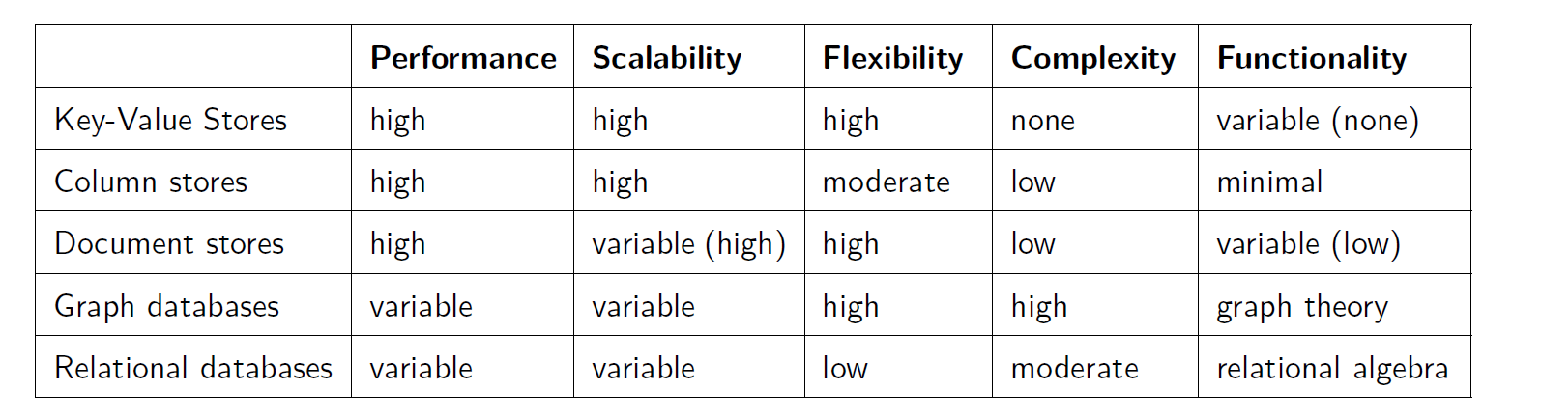
NoSQL DB Types

Slide 12
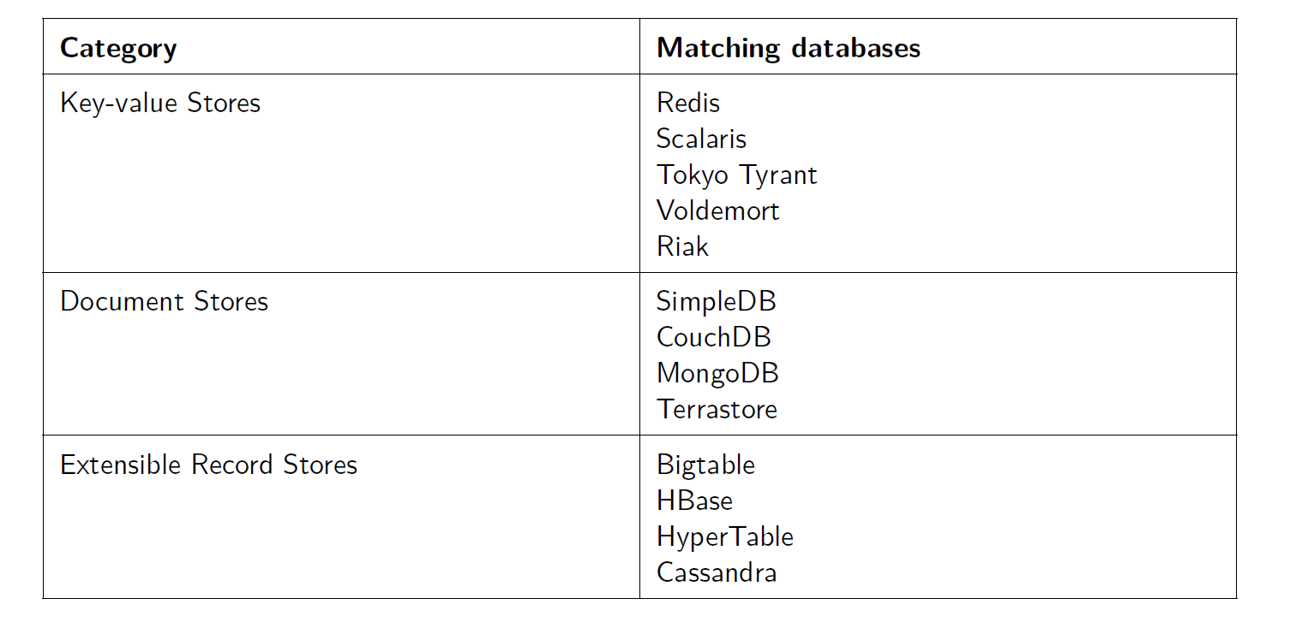
Classifications

Slide 13
Basic Concepts, Techniques and Patterns
Consistency : The CAP-Theorem
Consistency meaning if and how a system is in a consistent state after the execution of an operation. A distributed system is typically considered to be consistent if after an update operation of some writer all readers see his updates in some shared data source. (Nevertheless there are several alternatives towards this strict notion of consistency as we will see below.)
Availability and especially high availability meaning that a system is designed and implemented in a way that allows it to continue operation (i. e. allowing read and write operations) if e. g. nodes in a cluster crash or some hardware or software parts are down due to upgrades.
Partition Tolerance understood as the ability of the system to continue operation in the presence of network partitions. These occur if two or more “islands” of network nodes arise which (temporarily or permanently) cannot connect to each other. Some people also understand partition tolerance as the ability of a system to cope with the dynamic addition and removal of nodes (e. g. for maintenance purposes; removed and again added nodes are considered an own network partition in this notion.

Slide 14
CAP Theory
one can at most choose two of these three characteristics in a “shared-data system”
We can have different combinations of any two selections resulting into a different db specification,

Slide 15
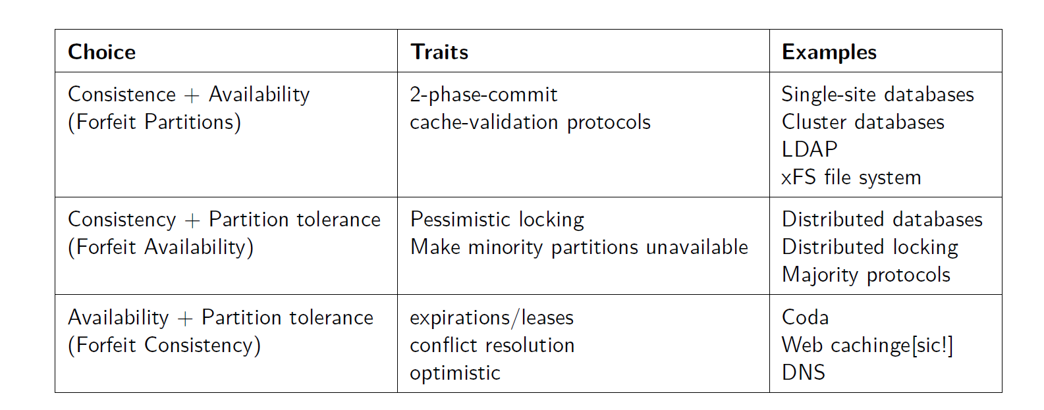
CAP

Slide 16
Basic Concepts, Techniques and Patterns
2. ACID vs. BASE As discussed above, the CAP-theorem states that a choice can only be made for two options out of consistency, availability and partition tolerance. These properties are difficult to achieve with ACID properties therefore approaches like BASE are applied, The acronym BASE is composed of the following characteristics:
Basically available
Soft-state
Eventual consistency
an application works basically all the time (basically available), does not have to be consistent all the time (soft-state) but will be in some known-state state eventually (eventual consistency)

Slide 17
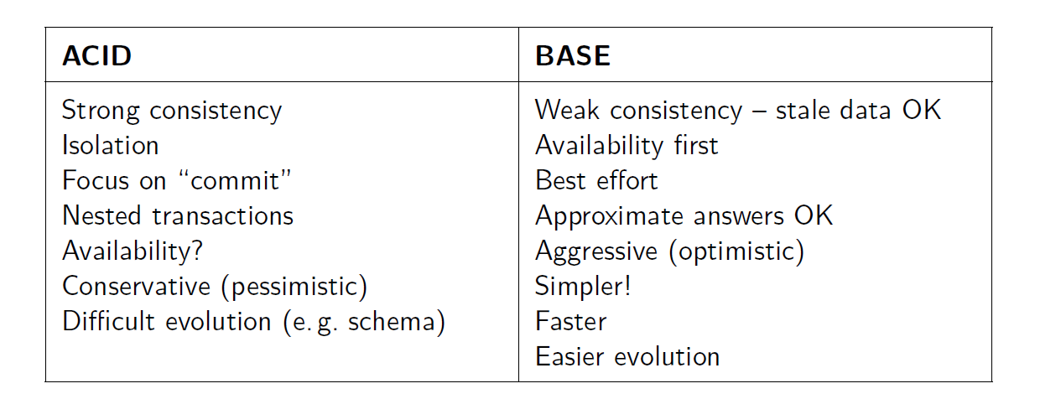
BASE vs ACID

Slide 18
BASE
Strict Consistency means that “All read operations must return data from the latest completed write operation, regardless of which replica the operations went to”. This implies that either read and write operations for a given dataset have to be executed on the same node2 or that strict consistency is assured by a distributed transaction protocol (like two-phase-commit or Paxos). As we have seen above, such a strict consistency cannot be achieved together with availability and partition tolerance according to the CAP-theorem.
Eventual Consistency means that readers will see writes, as time goes on: “In a steady state, the system will eventually return the last written value”. Clients therefore may face an inconsistent state of data as updates are in progress. For instance, in a replicated database updates may go to one node which replicates the latest version to all other nodes that contain a replica of the modified dataset so that the replica nodes eventually will have the latest version.

Slide 19
Key-/Value-Stores
Key-/value-stores have existed for a long time, emerged in the last couple of years has been heavily influenced by Amazon’s Dynamo.
Amazon’s Dynamo:
The infrastructure is made up by tens of thousands of servers and network components located in many datacenters around the world.
Commodity hardware is used.
Component failure is the “standard mode of operation”.
“Amazon uses a highly decentralized, loosely coupled, service oriented architecture consisting of hundreds of services.”
Strict, internal service level agreements (SLAs) regarding “performance, reliability and efficiency” have to be met in the 99.9th percentile of the distribution.
One of the most important requirements at Amazon is reliability “because even the slightest outage has significant financial consequences and impacts customer trust”.
“[To] support continuous growth, the platform needs to be highly scalable”.

Slide 20
Concepts Applied in Dynamo
“only store and retrieve data by primary key and do not require the complex querying and management functionality offered by an RDBMS”.
The design of Dynamo with a simple key/value interface storing values as BLOBs. Operations are limited to one key/value-pair at a time, so update operations are limited to single keys allowing no cross-references to other key-/value-pairs or operations spanning more than one key-/value-pair.
System Interface: The interface Dynamo provides to client applications consists of only two operations:
1 get(key), returning a list of objects and a context
2 put(key, context, object), with no return value
The get-operation may return more than one object if there are version conflicts for objects stored under the given key.
Handling of Failures: For tolerating failures provoked by temporary unavailability storage hosts, Dynamo is not employing any strict approach but a sloopy one. This approach implies that in the execution of read and write operations the first N healthy nodes of a data item’s preference list are taken into account.
A second measure to handle temporary unavailable storage hosts are so called hinted handoffs. They come into play if a node is note accessible during a write operation of a data item it is responsible for. In this case, the write coordinator will replicate the update to a different node, usually carrying no responsibility for this data item (to ensure durability on N nodes).

Slide 21
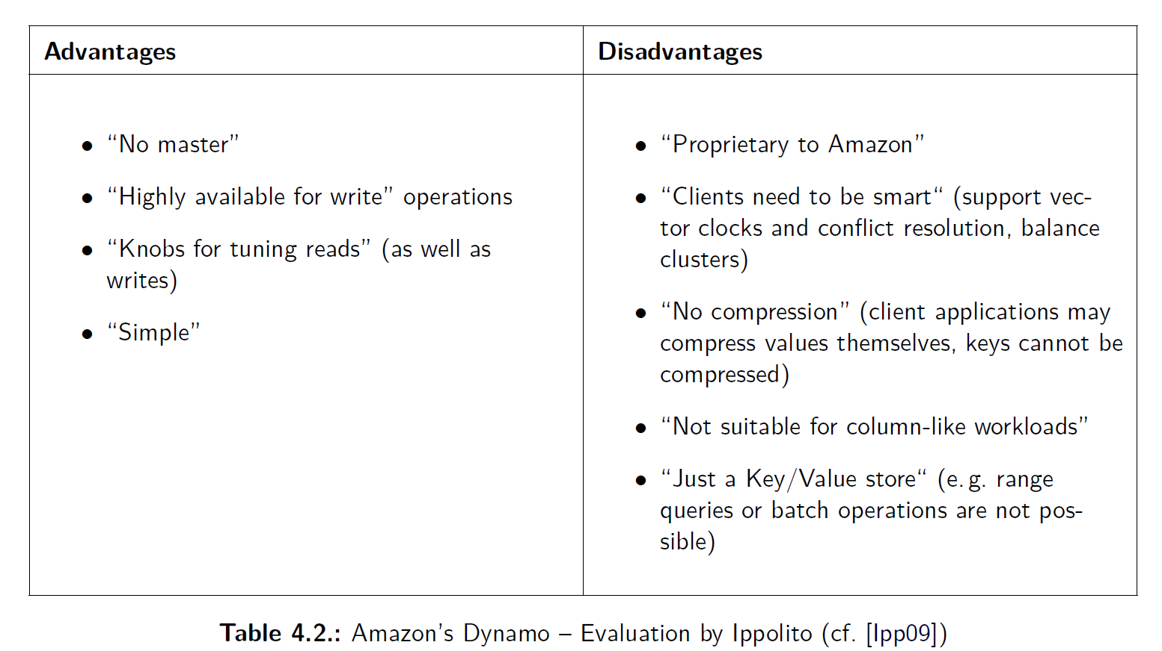
“Drop ACID and think about Data”

Slide 22
Project Voldemort
Project Voldemort is a key-/value-store initially developed for and still used at LinkedIn. It provides an API consisting of the following functions:
get(key), returning a value object
put(key, value)
delete(key)
Both, keys and values can be complex, compound objects as well consisting of lists and maps.

Slide 23
Project Voldemort
In the Project Voldemort design documentation it is discussed that—compared to relational databases—the simple data structure and API of a key-value store does not provide complex querying capabilities: joins have to be implemented in client applications while constraints on foreign-keys are impossible; besides, no triggers and views may be set up. Nevertheless, a simple concept like the key-/value store offers a number of advantages:
Only efficient queries are allowed.
The performance of queries can be predicted quite well.
Data can be easily distributed to a cluster or a collection of nodes.
In service oriented architectures it is not uncommon to have no foreign key constraints and to do joins in the application code as data is retrieved and stored in more than one service or datasource.
Gaining performance in a relational database often leads to denormalized datastructures or storing more complex objects as BLOBs or XML-documents.
Application logic and storage can be separated nicely (in contrast to relational databases where application developers might get encouraged to mix business logic with storage operation or to implement business logic in the database as stored procedures to optimize performance).
There is no such impedance mismatch between the object-oriented paradigm in applications and paradigm of the datastore as it is present with relational databases.

Slide 24
Document Databases
Document databases are considered by many as the next logical step from simple key-/value-stores to slightly more complex and meaningful data structures as they at least allow to encapsulate key-/value-pairs in documents. On the other hand there is no strict schema documents have to conform to which eliminates the need schema migration efforts

Slide 25
Document Databases:Apache CouchDB and MongoDB
Is a document database written in Erlang. The name CouchDB is nowadays sometimes referred to as “Cluster of unreliable commodity hardware” database . CouchDB can be regarded as a descendant of Lotus Notes (IBM). A lot of concepts from Lotus Notes can be found in CouchDB: documents, views, distribution, and replication between servers and clients. The approach of CouchDB is to build such a document database from scratch with technologies of the web area like Representational State Transfer (REST), JavaScript Object Notation (JSON) as a data interchange format, and the ability to integrate with infrastructure components such as load balancers and caching proxies.
CouchDB can be briefly characterized as a document database which is accessible via a RESTful HTTPinterface, containing schema-free documents in a flat address space. For these documents JavaScript functions select and aggregate documents and representations of them in a MapReduce manner to build views of the database which also get indexed.
The most notable use of CouchDB in production is ubuntu one the cloud storage and replication service for Ubuntu Linux .

Slide 26
CouchDB :Data Model and Key Abstractions
The main abstraction and data structure in CouchDB is a document. Documents consist of named fields that have a key/name and a value. A fieldname has to be unique within a document and its assigned value may a string (of arbitrary length), number, boolean, date, an ordered list or an associative map . Documents may contain references to other documents (URIs, URLs) but these do not get checked or held consistent by the database . A further limitation is that documents in CouchDB cannot be nested
A wiki article may be an example of such a document:

Slide 27
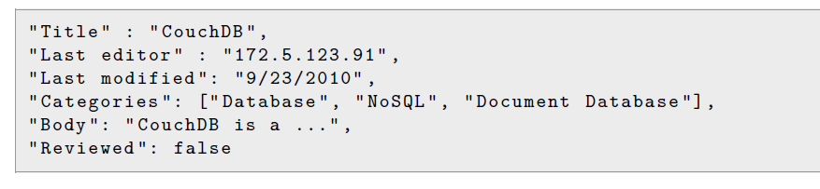
CoachDB

Slide 28
More details
Besides fields, documents may also have attachments and CouchDB maintains some metadata such as a unique identifier and a sequence id2) for each document . The document id is a 128 bit value (so a CouchDB database can store 3.4^38 different documents) ; the revision number is a 32 bit value determined by a hash-function3.
CouchDB considers itself as a semi-structured database. While relational databases are designed for structured and interdependent data and key-/value-stores operate on uninterpreted, isolated key-/value-pairs document databases like CouchDB pursue a third path: data is contained in documents which do not correspond to a fixed schema (schema-free) but have some inner structure known to applications as well as the database itself. The advantages of this approach are that first there is no need for schema migrations which cause a lot of effort in the relational databases world; secondly compared to key-/value-stores data can be evaluated more sophisticatedly (e. g. in the calculation of views). In the web application field there are a lot of document-oriented applications which CouchDB addresses as its data model fits this class of applications and the possibility to iteratively extend or change documents can be done with a lot less effort compared to a relational database.
Each CouchDB database consists of exactly one flat/non-hierarchical namespace that contains all the documents which have a unique identifier (consisting of a document id and a revision number aka sequence id) calculated by CouchDB. A CouchDB server can host more than one of these databases. Documents were formerly stored as XML documents but today they are serialized in a JSON-like format to disk . Document indexing is done in B-Trees which are indexing the document’s id and revision number (sequence id).

Slide 29
CoachDB
ACID Properties: According to the technical documentation ACID properties can be attributed to CouchDB because of its commitment system and the way it operates on files.
Atomicity is provided regarding single update operations which can either be executed to completion or fail and are rolled back so that the database never contains partly saved or updated documents.
Consistency can be questioned as it cannot mean strong consistency in a distributed CouchDB setup as all replicas are always writable and do not replicate with each other by themselves. This leads to a MVCC system in which version conflicts have to be resolved at read time by client applications if no syntactic reconciliation is possible.
Consistency of databases on single CouchDB nodes as well as durability is ensured by the way CouchDB operates on database files

Slide 30
MongoDB
MongoDB is a schema-free document database written in C++ and developed in an open-source project. the main goal of MongoDB is to close the gap between the fast and highly scalable key-/value-stores and feature-rich traditional RDBMSs relational database management systems. MongoDBs name is derived from the adjective humongous. Prominent users of MongoDB include SourceForge.net, foursquare, the New York Times.
Databases and Collections: MongoDB databases reside on a MongoDB server that can host more than one of such databases which are independent and stored separately by the MongoDB server. A database contains one or more collections consisting of documents. In order to control access to the database a set of security credentials may be defined for databases. Collections inside databases are referred to by the MongoDB manual as “named groupings of documents”.
Documents: The abstraction and unit of data storable in MongoDB is a document, a data structure comparable to an XML document, a Python dictionary, a Ruby hash or a JSON document. In fact, MongoDB persists documents by a format called BSON which is very similar to JSON but in a binary representation for reasons of efficiency and because of additional datatypes compared to JSON8.

Slide 31
MongoDB:
As an example, a document representing a wiki article may look like the following in JSON notation:

Slide 32
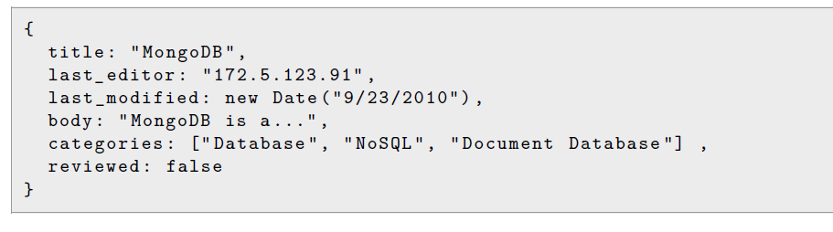

Slide 33
Column-Oriented Databases
The approach to store and process data by column instead of row has its origin in analytics and business intelligence where column-stores operating in a shared-nothing massively parallel processing architecture can be used to build high-performance applications. Notable products in this field are Sybase IQ and Vertica.
They are also described as “[sparse], distributed, persistent multidimensional sorted [maps]”
The main inspiration for column-oriented datastores is Google’s Bigtable, Hypertable and Hbase and Cassandra.

Slide 34
Google’s Bigtable.
Bigtable is described as “a distributed storage system for managing structured data that is designed to scale to a very large size: petabytes of data across thousands of commodity servers”, It is used by over sixty projects at Google as of 2006, including web indexing, Google Earth, Google Analytics, Orkut, and Google Docs.
These projects have very different data size, infrastructure and latency requirements: “from throughput-oriented batch-processing jobs to latency sensitive serving of data to end users. The Bigtable clusters used by these products span a wide range of configurations, from a handful to thousands of servers, and store up to several hundred terabytes of data”
“Bigtable has achieved several goals: wide applicability, scalability, high performance, and high availability”.
Bigtable is described as a database by Google as “it shared many implementation strategies with databases”, e. g. parallel and main-memory databases. However, it distinguishes itself from relational databases as it “does not support a full relational data model”, but a simpler one that can be dynamically controlled by clients. Bigtable furthermore allows “clients to reason about the locality properties of the data” which are reflected “in the underlying storage” . In contrast to RDBMSs, data can be indexed by Bigtable in more than one dimension—not only row- but also column-wise. A further distinguishing proposition is that Bigtable allows data to be delivered out of memory or from disk—which can be specified via configuration.

Slide 35
Google’s Bigtable
Data Model: The data structure provided and processed by Google’s Bigtable is described as “a sparse, distributed, persistent multidimensional sorted map”. Values are stored as arrays of bytes which do not get interpreted by the data store. They are addressed by the triple (row-key, column-key, timestamp).
Row keys in Bigtable are strings of up to 64KB size. Rows are kept in lexicographic order and are dynamically partitioned by the datastore into so called tablets, “the the unit of distribution and load balancing” in Bigtable.
The number of columns per table is not limited. Columns are grouped by their key prefix into sets called column families. Column families are an important concept in Bigtable as they have specific properties and implications:
-They “form the basic unit of access control”, discerning privileges to list, read, modify, and add column-families.
- They are expected to store the same or a similar type of data.
- Their data gets compressed together by Bigtable.
- They have to be specified before data can be stored into a column contained in a column family.
- Their name has to be printable. In contrast, column qualifiers “may be arbitrary strings”.
- The number of distinct column families in a table be small (in the hundreds at most), and that families rarely change during operation”.

Slide 36
Google’s Bigtable
Timestamps, represented as 64-bit integers, are used in Bigtable to discriminate different reversion of a cell value. The value of a timestamp is either assigned by the datastore , Bigtable orders the cell values in decreasing order of their timestamp value “so that the most recent version can be read first”.
API :The Bigtable datastore exposes the following classes of operations to client applications.
Read Operations include the lookup and selection of rows by their key, the limitation of column families as well as timestamps (comparable to projections in relational databases) as well as iterators for columns.
Write Operations for Rows cover the creation, update and deletion of values for a columns of the particular row. Bigtable also supports “batching writes across row keys”.
Write Operations for Tables and Column Families include their creation and deletion.
Administrative Operations allow to change “cluster, table, and column family metadata, such as access control rights”.
Server-Side Code Execution is provided for scripts written in Google’s data processing language Sawzall As of 2006, such scripts are not allowed to write or modify data stored in Bigtables but “various forms of data transformation, filtering based on arbitrary expressions, and summarization via a variety of operators”.
MapReduce Operations may use contents of Bigtable maps as their input source as well as output target.

Slide 37
BigTable
Bigtable depends on a number of technologies and services of Google’s infrastructure.
The distributed Google File System (GFS) is used by Bigtable to persist its data and log files.
As Bigtable typically shared machines with “wide variety of other distributed applications” it depends on a cluster management system “for scheduling jobs, managing resources on shared machines, dealing with machine failures, and monitoring machine status”.
Bigtable data is stored in Google’s SSTable file. A SSTable is a “persistent, ordered immutable map” whose keys and values “are arbitrary byte strings”. SSTables allow applications to look up values via their keys and “iterate over all key/value pairs in a specified key range”.

Slide 38
Implementation
Bigtable’s implementation consists of three major components per Bigtable instance:
Multiple tablet servers each of which is responsible for a number of tablets. This implies the handling of read and write requests for tablets as well as the splitting of tablets “that have grown too large”. Tablet servers can be added and removed at runtime.
A client library provided for applications to interact with Bigtable instances. The library responsible for looking up tablet servers that are in charge of data that shall be read or written, directing requests to them and providing their responses to client applications.
One master server with a number of responsibilities. Firstly, it manages the tablets and tablet servers: it assigns tablets to tablet servers, detects added and removed tablet servers, and distributes workload across them. Secondly, it is responsible to process changes of a Bigtable schema, like the creation of tables and column families. Lastly, it has to garbage-collect deleted or expired files stored in GFS for the particular Bigtable instance. Despite these responsibilities the load on master servers is expected to be low as client libraries lookup tablet location information themselves and therefore “most clients never communicate with the master”. As the master server is a single point of failure for a Bigtable instances it is backed up by a second machine

Slide 39
Derivatives
As the Bigtable code as well as the components required to operate it are not available under an open source or free software licence, open source projects have emerged that are adopting the concepts described in the Bigtable paper ,Notably in this field are Hypertable and HBase.

Slide 40
Hypertable
Hypertable is modelled after Google’s Bigtable and inspired by “our own experience in solving large-scale data-intensive tasks” according to its developers. The project’s goal is “to set the open source standard for highly available, petabyte scale, database systems”. Hypertable is almost completely written in C++ and relies on a distributed filesystem such as Apache Hadoop’s HDFS (Hadoop Distributed File System) as well as a distributed lock-manager. Regarding its data model it supports all abstractions available in
Bigtable; in contrast to Hbase column-families with an arbitrary numbers of distinct columns are available in Hypertable. Tables are partitioned by ranges of row keys (like in Bigtable) and the resulting partitions get replicated between servers. The data representation and processing at runtime is also borrowed fromBigtable:

Slide 41
Hypertable
Hypertable has its own query language called HQL (Hypertable Query Language) and exposes a native C++
HBase
The HBase datastore is a Bigtable-clone developed in Java as a part of Apache’s MapReduce-framework Hadoop, providing a “a fault-tolerant way of storing large quantities of sparse data”. Like Hypertable, HBase depends on a distributed file system (HDFS) which takes the same role as GFS in the context of Bigtable. HBase databases can be a source of as well as a destination for MapReduce jobs executed via Hadoop. HBase exposes a native API in Java and can also be accessed via Thrift or REST.

Slide 42
Cassandra
Apache Cassandra which adopts ideas and concepts of both, Amazon’s Dynamo as well as Google’s Bigtable. “distributed storage system for managing structured data that is designed to scale to a very large size” It “shares many design and implementation strategies with databases” but “does not support a full relational data model; instead, it provides clients with a simple data model that supports dynami control over data layout and format” , Facebook, as Twitter, Digg and Rackspace

Slide 43
Cassandra
The major requirements for the inbox search problem as well as problems of the same nature were:
Processing of a large amount and high growth rate of data (given 100 million users as of June 2008,250 million as of August 2009 and over 600 million users as of January 2011, 1500 million users 2014.
High and incremental scalability
Cost-effectiveness
“Reliability at massive scale” since “[outages] in the service can have significant negative impact”
The ability to “run on top of an infrastructure of hundreds of nodes [i. e. commodity servers] (possibly spread across different datacenters)”
A “high write throughput while not sacrificing read efficiency”
No single point of failure
Treatment of failures “as a norm rather than an exception”

Slide 44
Cassandra: Data Model
An instance of Cassandra typically consists of only one table which represents a “distributed multidimensional map indexed by a key”. A table is structured by the following dimensions.
Rows which are identified by a string-key of arbitrary length. Operations on rows are “atomic per replica no matter how many columns are being read or written”.
Column Families which can occur in arbitrary number per row. As in Bigtable, column-families have to be defined in advance, i. e. before a cluster of servers comprising a Cassandra instance is launched. The number of column-families per table is not limited; however, it is expected that only a few of them are specified. A column family consists of columns and supercolumns12 which can be added dynamically (i. e. at runtime) to column-families and are not restricted in number.
Columns have a name and store a number of values per row which are identified by a timestamp (like in Bigtable). Each row in a table can have a different number of columns, so a table cannot be thought of as a rectangle. Client applications may specify the ordering of columns within a column family and supercolumn which can either be by name or by timestamp.
Supercolumns have a name and an arbitrary number of columns associated with them. Again, the number of columns per super-column may differ per row.
Hence, values in Cassandra are addressed by the triple (row-key, column-key, timestamp) with columnkey as column-family:column (for simple columns contained in the column family) or column-family: supercolumn:column (for columns subsumed under a supercolumn).

Slide 45
Cassandra: API
The API exposed to client-applications by Cassandra consists of just three operations.
get(table, key, columnName)
insert(table, key, rowMutation)
delete(table, key, columnName)
The columnName argument of the get and delete operation identifies either a column or a supercolumn within a column family or column family as a whole .
All requests issued by client-applications get routed to an arbitrary server of a Cassandra cluster which determines the replicas serving the data for the requested key.

Slide 46
References:SQL vs. NoSQL databases:
One Size Fits All: An Idea whose Time has Come and Gone by Michael Stonebraker and Ugur Çetintemel: http://cs.brown.edu/~ugur/fits_all.pdf
What Should I do? – Choosing SQL, NoSQL or Both for Scalable Web Apps by Todd Hoff: http://voltdb.com/webcast-choosing-sql-nosql-or-both-scalable-web-apps
SQL Databases Don’t Scale by Adam Wiggins: http://adam.heroku.com/past/2009/7/6/sql_databases_dont_scale/
6 Reasons Why Relational Database Will Be Superseded by Robin Bloor: http://www.havemacwillblog.com/2008/11/6-reasons-why-relational-database-will-be-superseded/

Slide 47
Next
HADOOP

